Slide 1

Restaurant Rating Model
Yuri : data extraction
Akanksha : Load & Transform
Sarah & kurt : visuals & analysis

Slide 2
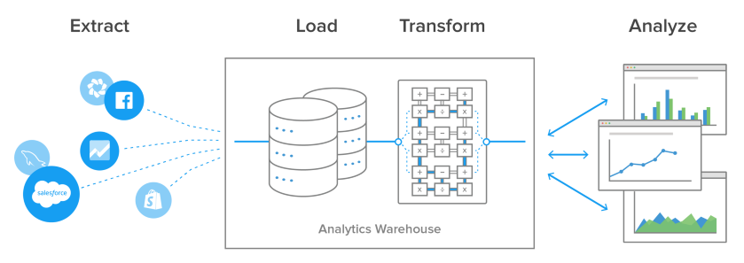
Restaurant Rating Model

Slide 3
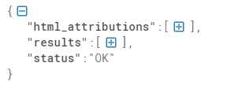
Load & Transform
Parent structure.

Slide 4
Load & Transform issues with data consistency
3 attributes
2 attributes
"name": "Krooked Moon Distillery",
"place_id": "ChIJeRfIYNDq24cRVoHiJSn0iMU",
"plus_code": {
"compound_code": "8FRQ+83 Owensville, MO, USA",
"global_code": "86CC8FRQ+83"
},
"price_level": 2,
"rating": 4.3,
"reference": "ChIJeRfIYNDq24cRVoHiJSn0iMU",
"scope": "GOOGLE",
"types": [
"bar",
"restaurant",
"food",
"point_of_interest",
"establishment"
],
"user_ratings_total": 104,
"vicinity": "1630 1002, West Franklin Avenue, Owensville"
},
"name": "Mama Bear\u2019s Grub & Pub",
"place_id": "ChIJz9AIRmjr24cRDAKjMU7mSC0",
"plus_code": {
"compound_code": "8FVR+QP Owensville, MO, USA",
"global_code": "86CC8FVR+QP"
},
"rating": 3.8,
"reference": "ChIJz9AIRmjr24cRDAKjMU7mSC0",
"scope": "GOOGLE",
"types": [
"restaurant",
"food",
"point_of_interest",
"establishment"
],
"user_ratings_total": 8,
"vicinity": "100 North 7th Street, Owensville"

Slide 5
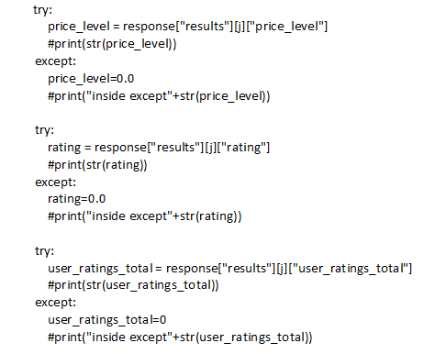

Slide 6
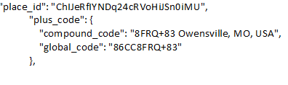
Load & Transform
city_state=response["results"][j]["plus_code"]["compound_code"]
# Using Regular expression(Regex) for slicing city and state
x = re.findall("(\w*),", city_state)
#print(x)
city = x[0]
state = x[1]
Python RegEx function
Import re

Slide 7
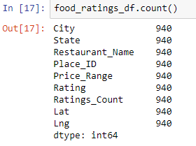
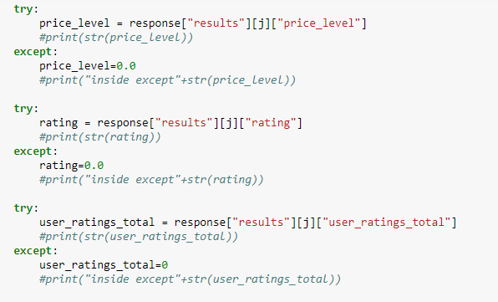
Load & Transform
Validation in place to ensure that all array has same length to create dataframe

Slide 8
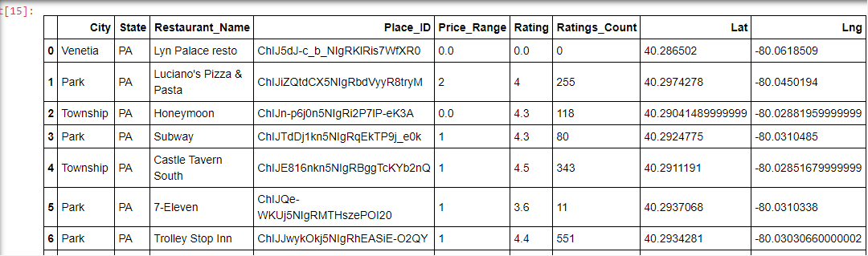
Load & Transform - Results

